Slide 1
HELMET DETECTION ON TWO-WHEELER RIDERS USING MACHINE LEARNING Authors: RAMESH BABU D R, AMANDEEP RATHEE, KRISHNANGINI KALITA, MAHIMA SINGH DEO Computer Science Department, DSCE, Bangalore, Karnataka International Journal of Advances in Electronics and Computer Science Volume-5, Issue-9, Sep.-2018 SAUMYA PATEL

Slide 2
Table of Contents
Introduction
Objective
Key Words
Methodology
Proposed method
Machine Learning Approaches
Existing State of Art
Results and Discussions
Conclusion
Future Recommendations

Slide 3
Introduction
Why we need this system?
Road safety is often neglected by riders worldwide leading to accidents and deaths.
Recently, helmets have been made compulsory, but still, people drive without helmets.
This sort of automation will help the administration to issue helmet violation tickets more efficiently, ultimately aiming to inhibit the violation by two-wheeler riders.

Slide 4
Objective
Solve this problem by automating the process of detecting the riders who are riding without helmets.
Extracting the license plate so that it could be used to issue traffic violation tickets.

Slide 5
Key Words
Machine Learning
Supervised Learning
Feature Extraction
Background Subtraction
MATLAB Functions

Slide 6
Methodology
The system implements machine learning and image processing techniques to detect riders, riding two-wheelers, who are not wearing helmets.
A video of traffic on public roads as the input and detects moving objects in the scene.
Machine learning classifier is applied to the moving object to identify if the moving object is a two-wheeler.
For two-wheeler, another classifier is used to detect whether the rider is wearing a helmet.
The license plate is provided as the output in case the rider is not wearing a helmet.

Slide 7
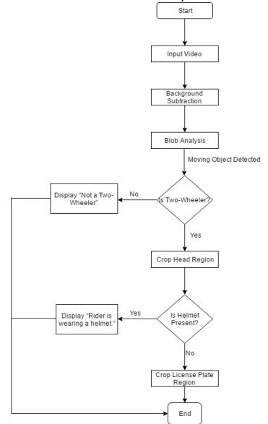
Proposed Method (1)
Moving Object Detection
Moving objects are segmented from the background.
Bounding boxes of each connected component corresponding to a moving vehicle.
Blobs consisting of less than n number of pixels are discarded
Morphological opening to remove the noise and to fill gaps
Raw image is extracted
Vehicle Classification
Captured images of various vehicles in various positions. Same number of images, 1000, for both the classes two-wheelers or four-wheelers.
Creation of variety of training samples using image augmentation.
Images were converted to grayscale.
Raw pixel values were fed to the classifier.
Flowchart of the proposed methodology

Slide 8
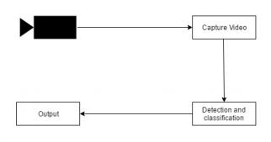
Proposed Method (2)
Helmet Detection
Same approach as applied to identify the type of vehicle
Cropped version of the two-wheeler images focusing on the head region of the rider used for training
Same number of images where the rider was wearing and not wearing a helmet.
License Plate Extraction
If rider of a two-wheeler is not wearing a helmet, then extract the license plate of the vehicle.
Extract the region of interest from cropped image by giving the appropriate coordinates.
System Architecture

Slide 9
Machine Learning Approaches
Random Forest
Instead of building one tree, a lot of trees are grown in parallel.
Trees are fed only a subset of data points and a subset of features.
Each tree votes for a class and a final class is chosen based on the highest number of votes.
Gradient Boosted Trees
Trees are constructed sequentially one after the other.
Each tree improves the loss by rectifying the error made by the previous tree while training.
Support Vector Machine
SVM creates a hyperplane and divides all the classes in the training data from one another
Takes a lot of computing resources to complete the training
Deep Neural Networks
Improvement over conventional neural networks.
Deep neural networks require a lot of training data

Slide 10
Existing State-of-Art
Circular arc detection method based on the modified Hough transform - This transformation has been applied to detect a helmet by an ATM surveillance system.
Background extraction algorithm - The algorithm is used to extract the foreground objects in the video. Then SIFT (Scale Invariant Feature Transform) algorithm is used to detect a moving object, that is a motorcycle. Using the Region of Interest (ROI), it chooses the location where the helmet can be found.
Effective enforcement of the use of a helmet by implementing RF communication-based helmet detection system.
Semiautomatic text extraction from Sri Lankan vehicle number plates

Slide 11
Results and Discussion
2000 images for training containing both, the front view and the back view of the vehicle.
Surveying of algorithms in R and final end-to-end system in MATLAB.
Separately tested for vehicle classification and helmet detection task.
Chosen metric : accuracy
For testing : 20% of the entire data
Random Forest | Gradient Boosted Trees | Support Vector Machine | Deep Neural Network
91% | 71% | 73% | 76%
Vehicle Classification Results
Random Forest | Gradient Boosted Trees | Support Vector Machine | Deep Neural Network
92% | 72% | 76% | 79%
Helmet Detection Results

Slide 12
Conclusion
Random forest outperforms all the other algorithms.
Deep neural network is expected to perform better than a random forest in image recognition, but due to lack of data, it does not perform as expected.

Slide 13
Future Recommendations
In the future, the system can be improved by scrutinizing its drawbacks.
System doesn’t work when there are multiple vehicles in the scene. it needs to recognize multiple vehicles and successfully perform all the tasks as it does in the case of a single vehicle.
The system can only output a license number using an OCR (Optical Character Recognition). Extracting the license number will allow the system to automatically send a ticket to the registered owner of the two-wheeler, in case they are not wearing a helmet

Slide 14
Thank you
.

